Slide 1





MAMC01803 Analytics for Managers
Week 5 (Session 1): Predictive Analytics (Forecasting)

Slide 2

In this lecture:
Topic 1: Predictive analytics

Slide 3
Predictive Analytics
The term predictive analytics refers to the use of statistics and modelling techniques to make predictions about future outcomes and performance.
Predictive analytics looks at current and historical data patterns to determine if those patterns are likely to emerge again.
We will be looking at:
Forecasting and Time Series <- We will be doing this today
Classification
Clustering

Slide 4
Time Series
This is a sequence of measurements taken at successive points in time. In other words, something that you track regularly for a period of time.
E.g. temperature every noon for the next week, or the stock price every hour for the next week. This list of temperatures or stock prices is a time series because the data is recorded at specific time intervals (every day at noon or every hour).
Time series helps you identify patterns over time or make predictions about future data.

Slide 5
Forecasting
Time-Series Forecasting Methods –Refers to the process of forecasting future outcomes based on time series data through various statistical techniques. In predictive analytics, forecasting is used to predict trends, behavior, or events that are likely to happen in the future.
Time series: used to record data over time.
Forecasting: uses the data from the time series to predict what will happen in the future.

Slide 6

Moving Average
A moving average in time series forecasting is a method used to smooth out fluctuations in data by averaging values over a specific number of periods. This helps in identifying trends by reducing short-term fluctuations.
E.g.: tracking your daily step count for a week. Some days you walk a lot, and some days you walk less. Instead of looking at just one day at a time, you take the average of the last few days to see the overall trend.

Slide 7
Let’s say you own a small bakery, and you track your daily sales. Your sales for the last five days are:
Monday: $200 Tuesday: $250 Wednesday: $180 Thursday: $300 Friday: $270
Some days are higher, some are lower—it’s a bit unpredictable. To get a clearer picture of your sales trend, you calculate a 3-day moving average.
For Wednesday, the 3-day moving average (using Monday, Tuesday, and Wednesday) is: (200 + 250 + 180)/3=$210.
For Thursday (using Tuesday, Wednesday, and Thursday): (250+180+300)/3=$243.3.
For Friday (using Wednesday, Thursday, and Friday):(180+300+270)/3=$250.
This way, instead of focusing on daily ups and downs, you see a smoother trend: Sales started at $210, then increased to $243, and further increased to $250. This suggests a positive trend—your bakery sales are improving over the week.

Slide 8
Why is this useful?
Helps you plan inventory (if sales are increasing, stock more ingredients).
Assists in staffing decisions (if sales peak on certain days, schedule more employees).
Improves forecasting (so you can predict future sales and set targets).

Slide 9
Moving Average Graph

Slide 10
Exponential Smoothing
Exponential smoothing is a forecasting method that gives more importance to recent data while still considering past data.
Unlike a simple moving average, which treats all past values equally, exponential smoothing assigns a higher weight to recent sales and a lower weight to older sales.
This makes it more responsive to recent changes in trends.

Slide 11
Exponential Smoothing
Formula for Exponential Smoothing: St = α * Xt + (1−α) * St-1
Where:
St​ = Smoothed value at time
Xt = Actual sales at time
α = Smoothing factor (between 0 and 1)
St-1​ = Previous smoothed value
The smoothing factor (α) determines how much weight is given to recent data:
Higher α (e.g., 0.8-0.9) → More responsive to recent changes.
Lower α (e.g., 0.1-0.3) → More stable, but slower to react to new trends.

Slide 12
Using Exponential Smoothing for Bakery Sales Example
Given sales data: Monday: $200 Tuesday: $250 Wednesday: $180 Thursday: $300 Friday: $270
Let’s assume an initial smoothed value (starting point) is Monday’s sales: S1=200 We choose α=0.5 (giving equal importance to past and recent values).
Now, we calculate smoothed sales for each day:
Tuesday: S2=0.5*250+(1−0.5)*200=125+100=$225
Wednesday: S3=0.5*180+(1−0.5)*225=$202.5
Thursday: S4=0.5*300+(1−0.5)*202.5=$251.25
Friday: S5=0.5*270+(1−0.5)*251.25=$260.63

Slide 13
What does this tell us?
The smoothed values help reduce daily fluctuations and provide a clearer trend.
The bakery sales are increasing over time, so you might need to prepare for higher demand.
If you see a downward trend, you can adjust your marketing or pricing strategy.

Slide 14
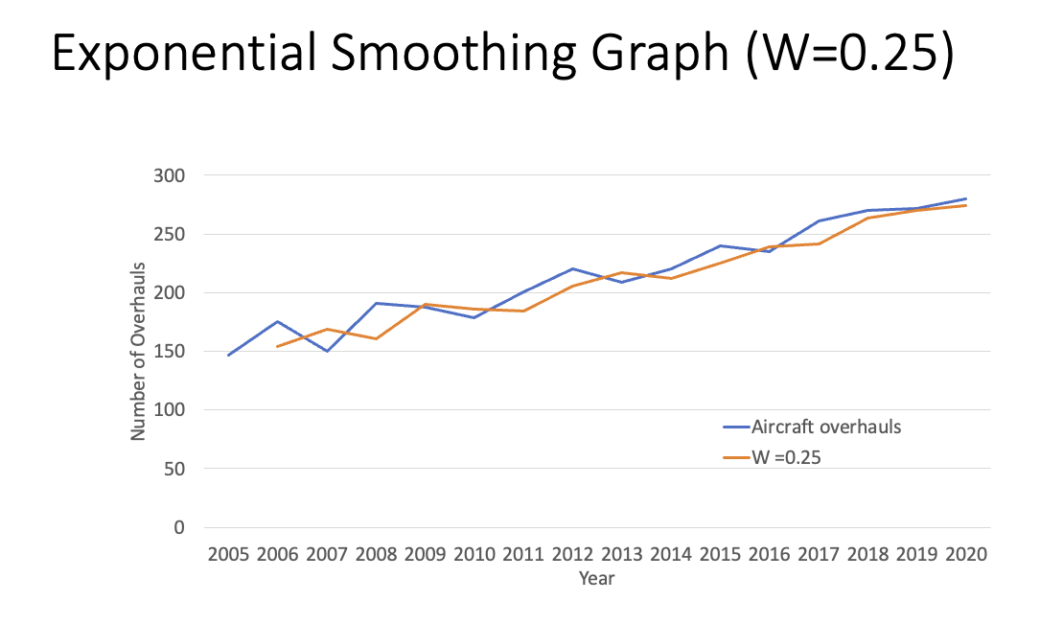
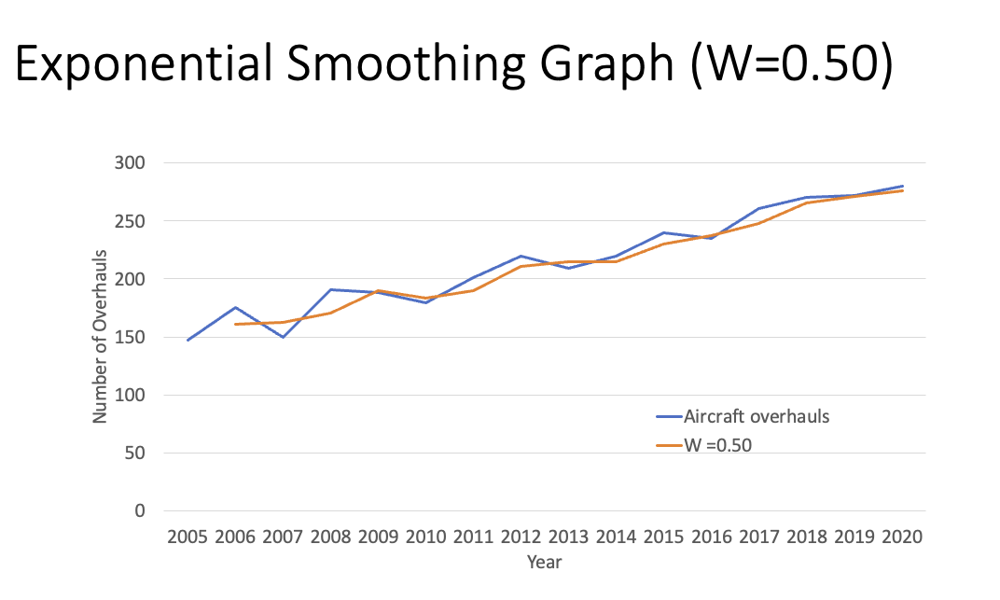
Exponential Smoothing

Slide 15
Individual tasks and group discussion: Predictive analytics
Please complete the following tasks：
Download the activity dataset (i.e., “Aircraft.xls”) from Teams
(1) Plot the time series ;
(2) Does the series indicate a particular pattern in the plot in (1)?
(3) Use an appropriate method to force the series;
E.g., moving average; exponential smoothing
(4) How accurate is this method in forecasting the current series?
(5) Calculate overhaul forecast for years 2021, 2022 and 2023.
Note: You could use your own dataset to complete the above analysis.

